Slide 1
DOM Manipulation
Front-End Web Development

Slide 2
Lesson 10 Change Log FEWD 3.1–3.2
Below are the specific changes made in this lesson.
Returning Instructor Directions:
Click on the hyperlinks below, and it will direct you to the specific slide.
Copy the entire slide, and paste in your existing curriculum deck.
Pre-Class Materials and Preparation - Added one new CodePen — JS Greeting Example — to Reference Code.
Share how the lesson went through our Instructor Lesson Exit Ticket - the Curriculum Feedback form: http://ga.co/curriculum-feedback

Slide 3
Pre-Class Materials and Preparation
Review all slides, lab activities, and code-alongs.
There are prompts in the speaker notes with opportunities for instructor customization.
Materials:
Reference Code
Starter Code in CodePen
Solution Code in CodePen

Slide 4
DOM Manipulation
Overview
This lesson introduces the role of JavaScript in altering, creating, and removing page elements using DOM manipulation.
Learning Objectives
In this lesson, students will:
Identify the role of JavaScript in front-end web development.
Access properties of the DOM using JavaScript object syntax.
Use DOM methods to respond to user actions with event listeners.
Duration: 180 minutes

Slide 5
Suggested Agenda
Time | Activity | Purpose
0:00–0:20 | What Is JS? | Get students thinking about how JS fits into the bigger picture. Set the stage for DOM manipulation as JS’ superpower.
0:20–1:30 | DOM Getters/Setters and Walk-Through | Introduce DOM properties and methods. Demonstrate with the codepen or even in browser console how these work. Emphasize the pattern of *getting* a DOM object then using methods/properties to *set* new properties on them.
1:30–2:00 | Event Listeners Walk-Through | This should reveal why functions are so important — setting up repeatable processes that the user can trigger on demand.
2:00–2:30 | Color Switcher | Practice in pairs with the new techniques. Be very active in supporting students through this first DOM experience.
2:30–3:00 | Traffic Light | Independent practice with DOM events. This will be difficult for students, so frame it accordingly.

Slide 6
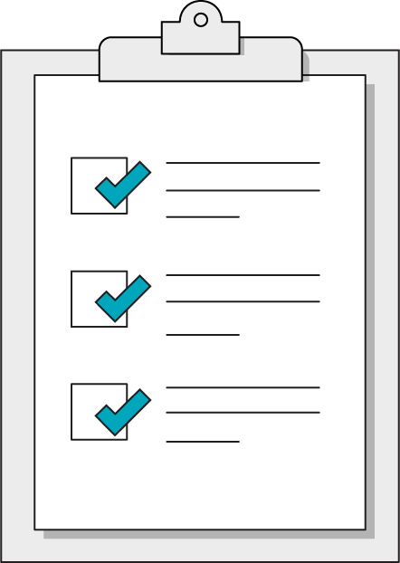
Today’s Learning Objectives
In this lesson, you will:
Identify the role of JavaScript in front-end web development.
Access properties of the DOM using JavaScript object syntax.
Use DOM methods to respond to user actions with event listeners.
‹#› | © 2020 General Assembly
Notes:
DURATION: 1 minute
TEACHING TIPS:
Learning objectives help frame the lesson and give students an idea of what to expect and focus on.
Explain to students how this lesson fits into the overall course to help them make connections with content from other lessons.

Slide 7

What Is JS?
15 minutes
Now that we’ve met all three front-end technologies, what exactly does JavaScript do for us? How do HTML, CSS, and JS intersect?
Draw a Venn diagram illustrating the roles of each technology and where they intersect.
Notes:
TEACHING TIPS:
This could be a good opportunity to draw a Venn diagram between the three. Semantic HTML and container elements could the overlap of HTML and CSS, for example.
Venn diagram example: https://www.penflip.com/tanya/building-the-web-slideshow/blob/master/pagestructure/languages.md
You could also use the Venn diagram as an opportunity to review the key HTML/CSS points learned thus far.

Slide 8

What Does JavaScript Do?
Responds to user actions, called events, to change the HTML content/ CSS styles of a webpage.
Loads data from and sends data to servers, databases, and other websites.
Programs complex instruction sets like algorithms, machine learning, crypto, etc.

Slide 9
Conditionals
Front-End Web Development

Slide 10
Making Decisions
It's either TRUE or FALSE (like booleans)
If you are greater than 18 you are an adult
if (age > 18) {
document.write("You are an adult");
}
Notes:
TALKING POINTS:
Open DevTools and type in the word “document” to see what’s returned.

Slide 11
Testing Equality
10 === 10 //true
10 === 5 //false
"hi" === "hi" //true
Notes:
TALKING POINTS:
Open DevTools and type in the word “document” to see what’s returned.

Slide 12
Comparison Syntax
if(condition is true) {
//Do cool stuff
}
Notes:
TALKING POINTS:
Open DevTools and type in the word “document” to see what’s returned.

Slide 13
Comparison Syntax
if(condition is true) {
//Do cool stuff
}else{ //Do different cool stuff }
Notes:
TALKING POINTS:
Open DevTools and type in the word “document” to see what’s returned.

Slide 14
Multiple Conditions
if (name == "GA" && password == "Pencil"){
//Allow access to internet
}
Notes:
TALKING POINTS:
Open DevTools and type in the word “document” to see what’s returned.

Slide 15
Multiple Conditions
if (day == "mon" || day == "wed"){
//We Have Class Today
}
Notes:
TALKING POINTS:
Open DevTools and type in the word “document” to see what’s returned.

Slide 16
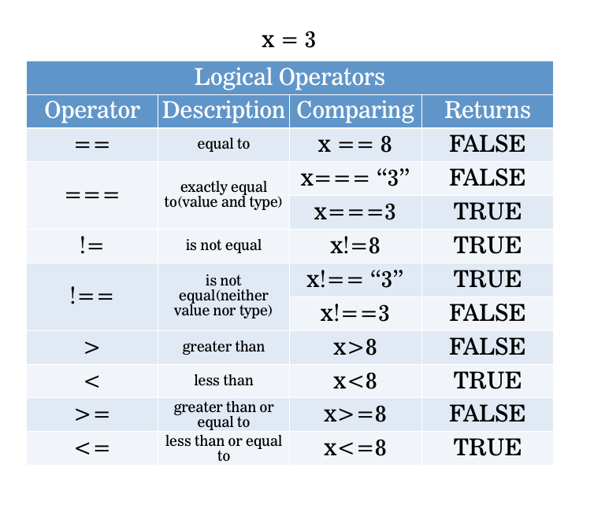
Making Decisions
Remember:
= assigns == tests equivalence === tests equivalence + type
Notes:
TALKING POINTS:
Open DevTools and type in the word “document” to see what’s returned.

Slide 17
Compare That
Let’s see how we can attach event listeners by grabbing elements with either class or ID selectors.
Starter code:
https://drive.google.com/drive/folders/1wBGy9rEoKAyIvKVEZ4NiSlc4VW5fJQ7U?usp=sharing
Solution code:
https://drive.google.com/drive/folders/1wBGy9rEoKAyIvKVEZ4NiSlc4VW5fJQ7U?usp=sharing
Notes:
To walk the students through this, you’ll need to introduce parseFloat and parseInt

Slide 18
Most JavaScript is the combination of two concepts: What and When
‹#› | © 2020 General Assembly

Slide 19
The What: The Webpage Object
Front-End Web Development

Slide 20
A Webpage Is One Giant JS Object
Window
Document
Console

Slide 21
Everything you see in the browser is a
JS object.
‹#› | © 2020 General Assembly

Slide 22
Three Big Objects
Window
Document
Console
The whole web browser; mostly used for browser-level settings.
The current webpage. This object has the functionality we want to use when accessing elements on the page.
A scratch pad for development-related messages; highly useful in debugging.

Slide 23
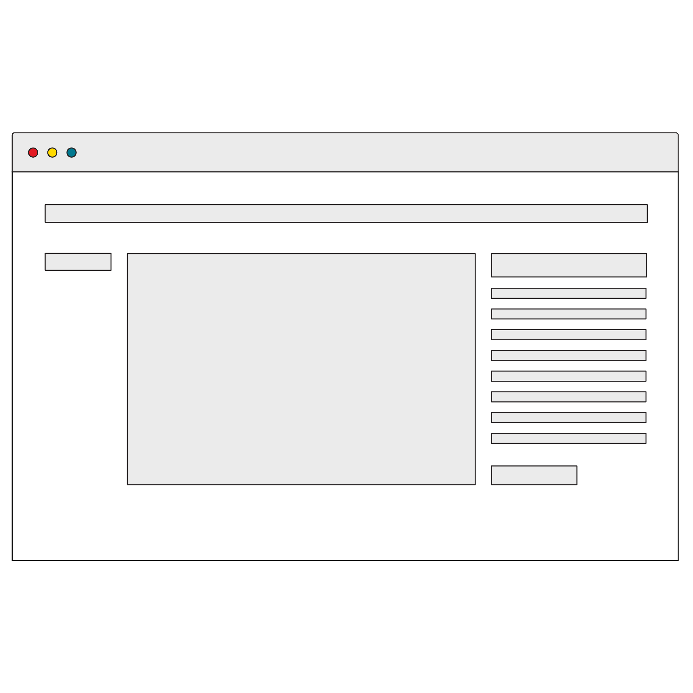
The DOM
Browsers read your HTML and create an object in the computer’s memory for each part. That HTML layout is called a “data model” because it describes the structure of your webpage.
The Document Object Model (DOM) is the browser’s JavaScript representation of your HTML elements.
Notes:
TALKING POINTS:
Open DevTools and type in the word “document” to see what’s returned.

Slide 24
Getters and Setters
The main thing we’re doing with JS is getting objects from the DOM and performing actions with them (moving, hiding, etc).
The methods that get something from a webpage are called getters.
The methods that change something on the webpage are called setters.

Slide 25
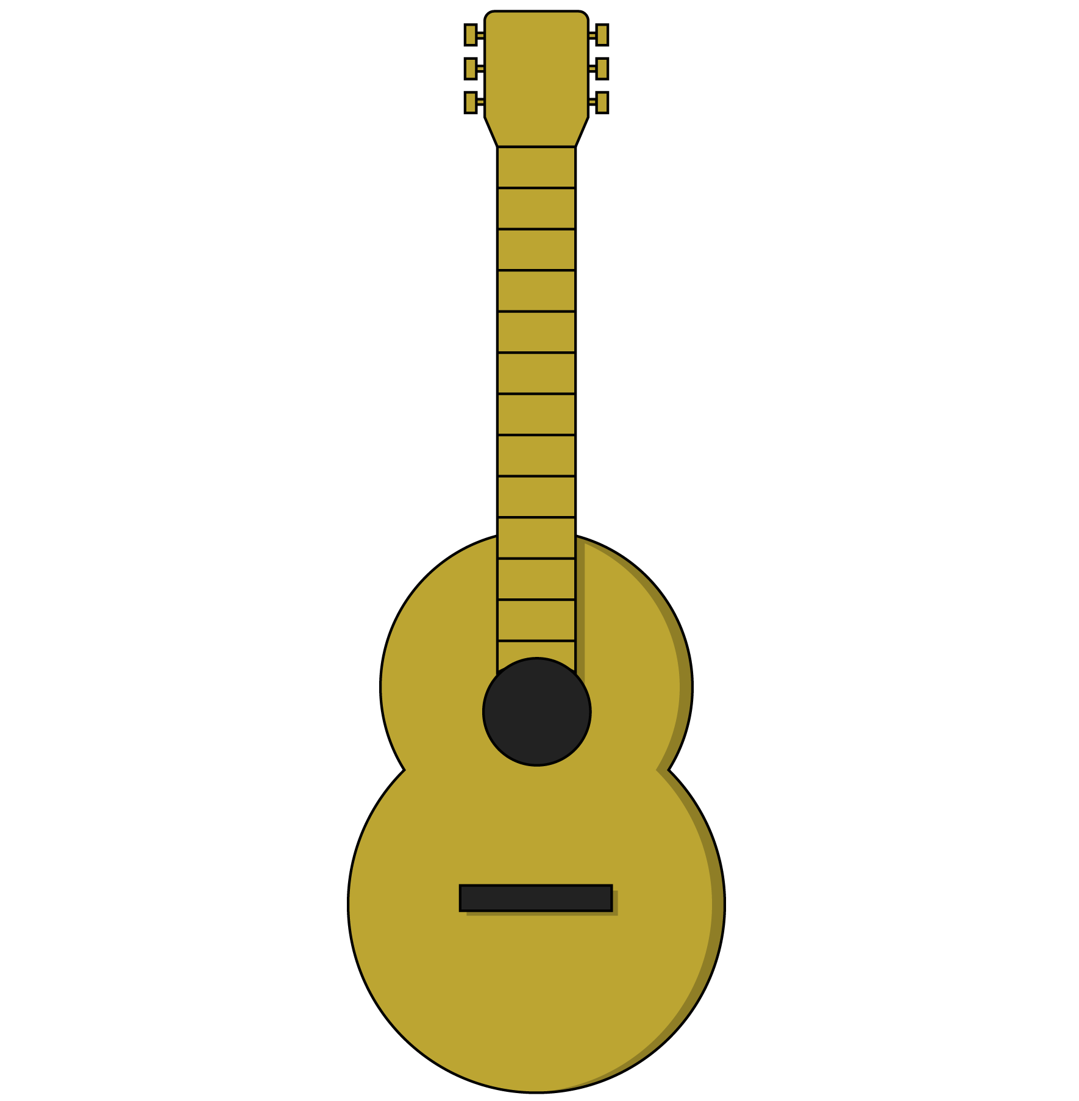
Methods
Getters and setters access and modify objects. They are both types of methods. Methods belong to JavaScript objects, including DOM elements.
Think of methods as the functions that an object can use. A guitar, for example, might have the following methods:
guitar.playChord(chord)
guitar.playNote(note)
guitar.changeTempo(tempo)
guitar.changeVolume(volume)

Slide 26
Properties
Objects often have metadata — information that describes the object (height, width, classes, etc). These pieces of information are called properties.
Property | Description
someElement.classList | A list of the classes belonging to a DOM element.
someElement.id | The ID of an element, if it has one.
someElement.style.color | The color of an element’s text.
window.location.href | The window object’s location details, including the page’s href (hypertext reference/URL).
Notes:
TEACHING TIPS:
Students may recognize some as HTML attributes or CSS properties. Emphasize the concept of key:value pairs throughout programming.

Slide 27
What Does a Real Piece of Code Look Like?
document.getElementById(‘ga’);
Object
Method (getter)
Parameter
Notes:
TALKING POINTS:
This gets an element with the ID of ga from the DOM. This would RETURN an object, our DOM element, so that we could then manipulate it.

Slide 28
Getters
Getters often fill in variables in your JS. Once you get something from the DOM, you can use a variable to store it in memory for future manipulation.
const gaData = document.getElementById(‘ga’);
Now that we have our element, gaData, we can access its properties:
gaData.style.color;
gaData.innerText;
gaData.classList;

Slide 29
We’re mostly going to manipulate classes to make things happen on our pages.
‹#› | © 2020 General Assembly

Slide 30
Manipulating an Element’s Classes
gaData.classList.toggle(‘show’);
Object
Property
Parameter
Method (setter)
This statement takes the ga object, looks at the element’s list of classes, and toggles the show class on or off.
Notes:
TALKING POINTS:
Note that you can combine properties and methods, as properties can have their own methods.

Slide 31
DOM Reference Code
Let’s look at some DOM properties and methods in action! There’s no need to feel overwhelmed by details — the patterns are what matter.
Reference code:
https://drive.google.com/drive/folders/1DcHwmAhyWSrlAbL3vs0kgjvr3TZd75od?usp=sharing
‹#› | © 2020 General Assembly
Notes:
TEACHING TIPS:
Take your time going through this section. Use it to change stuff around and show students what’s possible.

Slide 32
The When: Event Handling
Front-End Web Development

Slide 33
Events and Listeners
Anytime a user interacts with a webpage, the browser classifies that action as an event.
In our JS code, we can listen for events in the browser and trigger functions in response using event listeners.
// When object is clicked, the action function is called object.addEventListener(‘click’, action)
Notes:
TALKING POINTS:
Mouse/finger movements on the screen, clicks, hovers, and key presses are all considered events in JavaScript.

Slide 34
Get, Then Listen
We’ll often get an element and then set an event listener on it. Once the event occurs, the listener will execute the function it was given.
const ga = document.getElementById(‘ga’);
function sayHello(){ console.log(“hello!”);
} ga.addEventListener(‘click’, sayHello)
Notes:
TEACHING TIPS:
Emphasize that this is another repeated pattern throughout DOM manipulation; GET the thing we want, then SET some aspect of it according to what we want to do with it.

Slide 35

Events to Listen For
Click is the most common, but what other events might we want to listen for?
Notes:
TEACHING TIPS:
Hopefully answers lead you to some of the following: Hover, keypress, keydown, keyup, focus, scroll, select, submit.
Try testing out some of the most common event types: https://www.w3schools.com/js/js_htmldom_events.asp.

Slide 36
Event Listeners With Selectors
Let’s see how we can attach event listeners by grabbing elements with either class or ID selectors.
Code with class selectors:
https://drive.google.com/drive/folders/1mm1rkPgnUzgDD-NsIHy4lQU-8jCyn9Bb?usp=sharing
Code with ID selectors:
https://drive.google.com/drive/folders/1QiTumxSp4joe6-y93PvTsAx0_xD8G4gv?usp=sharing

Slide 37
Color Switcher
30 minutes
In this exercise, we’ll use our new event-listening skills to create a color switcher!
Bonus: Try adding more switcher elements that change more colors.
Starter code:
https://drive.google.com/drive/folders/1ekSei8Da5QdZRP9iabhoLzYMYYxpiBOL?usp=sharing
Solution code:
https://drive.google.com/drive/folders/1czuJ8b5gjWcC8byLrsaP3_G_0ljtLtbM?usp=sharing

Slide 38
Traffic Light
45 minutes
In this exercise, write JavaScript that uses buttons to control the traffic light. Only ONE color should be active at a time!
Starter code:
https://drive.google.com/drive/folders/1QkYpHVmIRTsHN5zQ_FKr4m3iuum3Jmhp?usp=sharing
Solution code:
https://drive.google.com/drive/folders/1OvbdYhbT93XUGEsOxWyTDCVegC9z2YHJ?usp=sharing
Notes:
TEACHING TIPS:
If you have extra time after this in the class, feel free to use the historical appendix of what makes JavaScript so unique and why it is the way it is...

Slide 39
Key Takeaways
For Next Time
Everything Is JavaScript!
JavaScript Practice!
HTML elements are represented as objects in the DOM.
DOM objects have getters and setters to manipulate properties.
Event listeners attach to objects and use functions to respond to user actions.
We learned a lot of new concepts in this lesson. Next time, we’ll put them into practice.
‹#› | © 2020 General Assembly

Slide 41
JavaScript Has a Weird History
Front-End Web Development

Slide 42
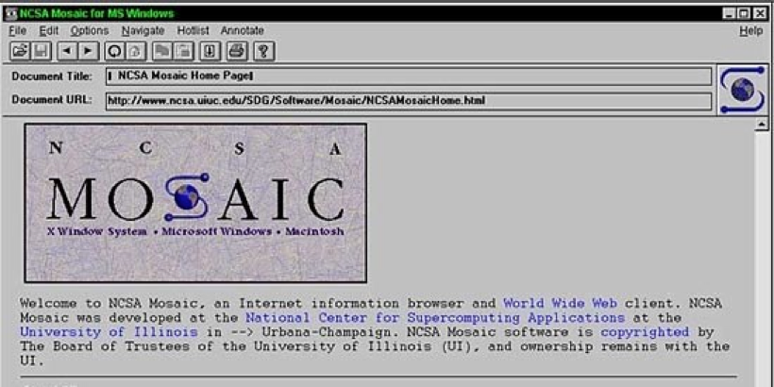
Mosaic: The First Browser
Notes:
TALKING POINTS:
That U.S. National Center for Supercomputing Applications (NCSA) released Mosaic, the first graphical web browser, free of charge. Those engineers would go on to form Mosaic Netscape (codenamed “Mozilla”), and then rename their company Netscape Navigator. It quickly became the default browser for the internet (in the mid-1990s).

Slide 43
Web = Open Platform
From the beginning, the web (which isn’t the same thing as the internet) was conceived as an open medium of exchange. Its architecture assumes good faith on the part of its users, for better or worse.
Notes:
TALKING POINTS:
The web as an open medium of exchange was the basis of this concept. This is very important to understanding why the web is the way it is today. Its builders weren’t typical capitalist-minded business people (at least at first). They saw the world differently, and it’s worth reading more about this history.

Slide 44

The Birth of JavaScript
Brendan Eich developed a programming language for Netscape’s browser in 10 days, which became what is now JavaScript.
Notes:
TALKING POINTS:
Netscape was an innovative early company, which saw the browser as a pay-per-download program — a revolutionary idea at the time. It developed a programmatic language (led by Brendan Eich) for the web as part of its browser called “JavaScript.” It was developed in only 10 days!

Slide 45
The Roaring ’90s
Developers wanted to make this a standard and turned it over to ECMA, a European standards organization.
ECMA came up with ECMAScript 1, 2, and finally version 3 in 1999 — all based off of Netscape's work. Netscape effectively open-sourced JS to the world.

Slide 46
ECMA vs. JS
You'll see ECMAscript and JS used interchangeably a lot online. ECMA is the standards body that controls the baseline actual baseline of JavaScript.
Other languages can be derived from ECMA standards, but JS is far and away the most popular, hence the confusion.

Slide 47
JScript and Internet Explorer
Microsoft, which had developed Windows into a monopoly desktop operating system, saw the popularity of Netscape and tried to reverse engineer how JS worked without given it backward compatibility to Netscape's real version of JS. This led to JScript, a non-compatible JS-like scripting language for Internet Explorer.
Notes:
TALKING POINTS:
Keep the time frame in mind: This is the late 1990s — the internet is not really used at a large scale yet so these decisions have little impact on anyone (the modern equivalent would be what's going on with cryptocurrency now: a major technology without adoption).

Slide 48
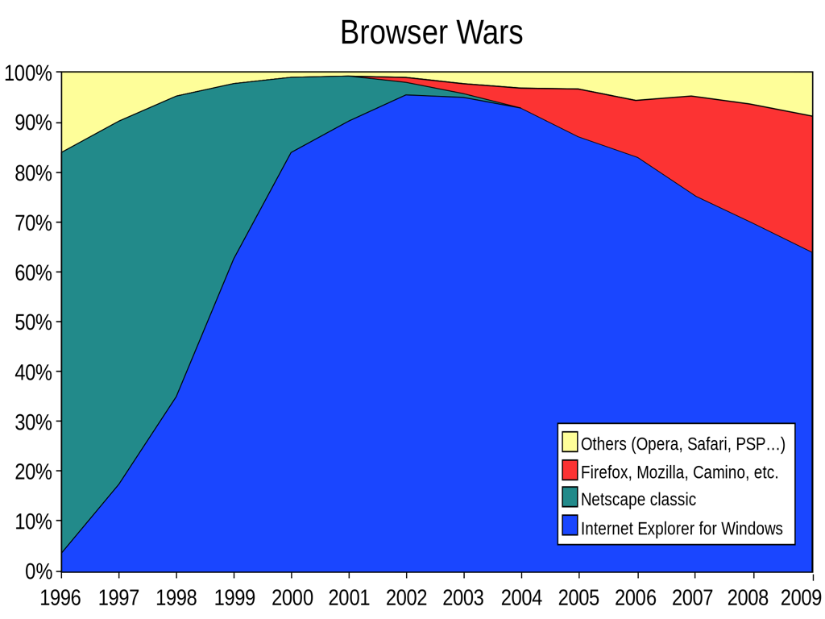
‹#› | © 2020 General Assembly

Slide 49
IE Takeover
With its monopoly power, MS pushed a free version of IE without JS onto every computer. This significantly set the internet back.
A broad-scale tech industry war broke out as Microsoft destroyed Netscape and assumed the position as the only browser vendor in the early 2000s. Microsoft faced anti-monopoly legislation for doing this but the court case took a LONG time.

Slide 50
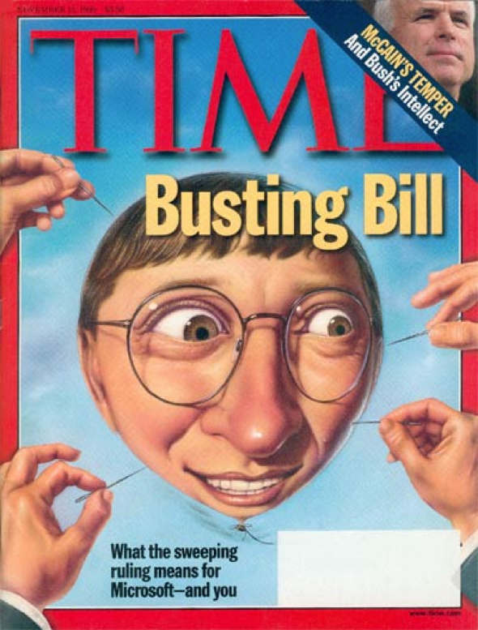
‹#› | © 2020 General Assembly

Slide 51
The Dark Ages
Early–mid-2000s
This was a dark period for the internet. There wasn't a scripting language standard, and major work around JS stopped at ECMA because of disagreements between major vendors.
The end result was that programs couldn’t really be programs on the internet because they were missing functional pieces browsers didn't have (Microsoft actively wanted the web to stay small so it wouldn't impact its desktop monopoly).

Slide 52
Open Source Rises
The open-source community began to try to overcome the IE monopoly.
Netscape's core code was open-sourced under the original codename “Mozilla” and then eventually Mozilla Firefox in 2005.

Slide 53
jQuery to the Rescue!
The real tipping point was the most ingenious solution to the IE compatibility issues: John Resig reverse-engineered how JavaScript operated and then made a new JS-like, open-source language that worked on every browser, including IE.
It was called jQuery and took off around 2006–2007.

Slide 54
JS Standardizes
2008 saw Google Chrome released, which followed in the footsteps of Firefox — both championing a singular version of JS. 2009 saw the reemergence of ECMA group, rebranding ECMAScript to Version 5.
This is when the internet exploded with possibilities (we’re living in the result).

Slide 55
Finally, Real JS
Now, Mozilla and Chrome pushed a singular version of JS for the first time. It would take Microsoft many years to admit defeat and join the standard, but by around 2013–2014, a common-form of JS would work in every browser (ES5) with the release of the last version of IE (Version 11).

Slide 56
ES6+
2015 saw the release of ES6, which was a dramatic expansion of the baseline JS toolkit, and it was taken up rapidly by all browser vendors.
There is now a yearly release of JS that adds new features (called ESYYYY — so, like ES2020).

Slide 57
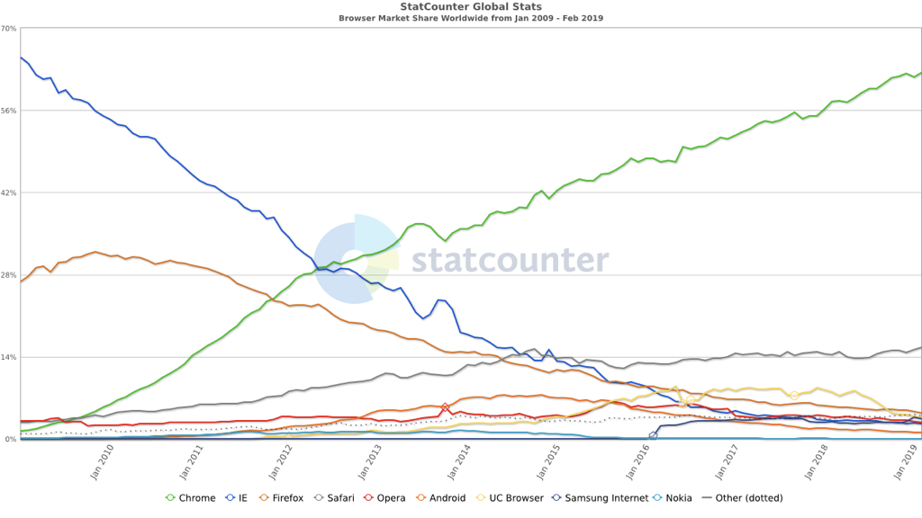
Browser Share

Slide 58
What Makes JS Special?
It has overcome a ridiculous history.
All programming languages require code to be compiled before viewing.
JavaScript is unique because its compiler is your browser, so you can see your work immediately.

